Slide 1
Electrical Machine-I
EE 2107
Dr. Md. Sherajul Islam
Associate Professor
Department of Electrical and Electronics Engineering Khulna University of Engineering & Technology
Khulna, Bangladesh

Slide 2
Transformer

Slide 3
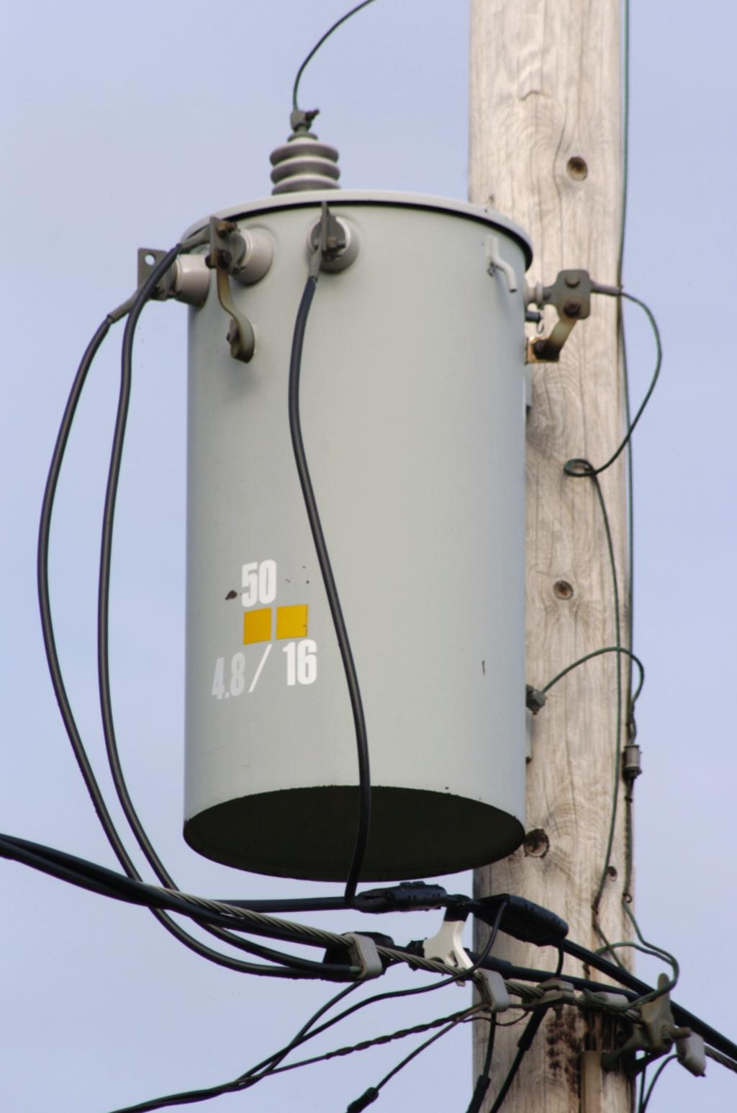
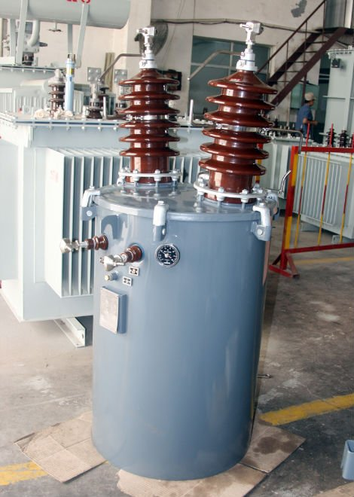
Physical image of Transformer

Slide 4
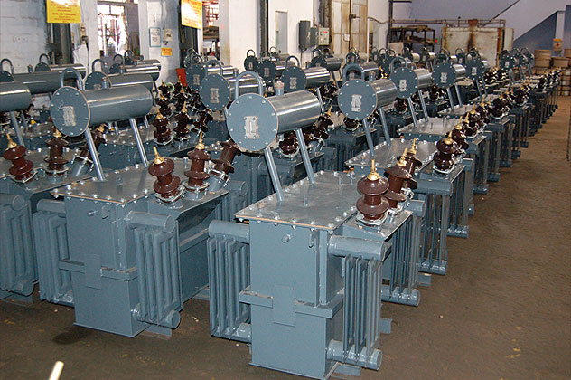
Physical image of Transformer

Slide 5
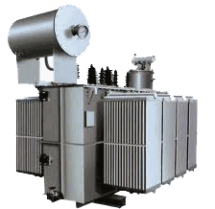
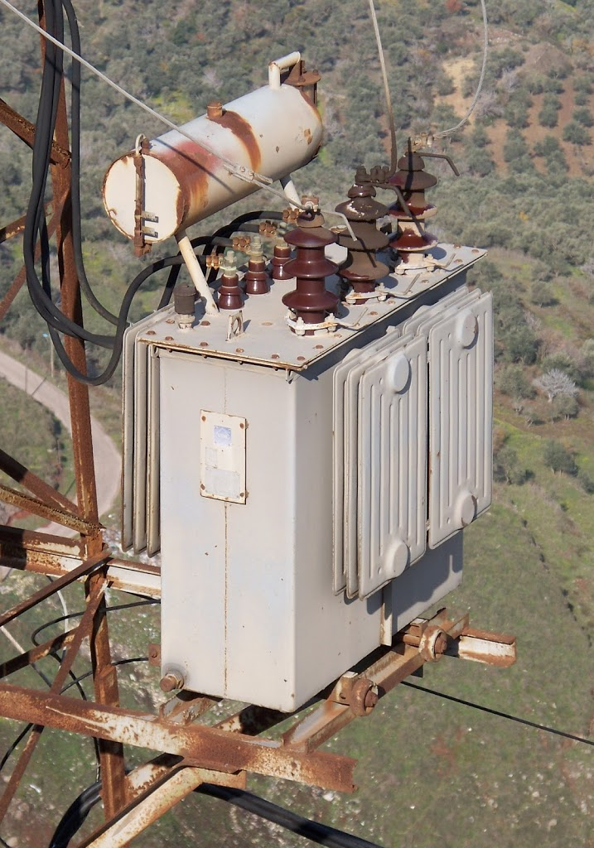
Physical image of Transformer

Slide 6
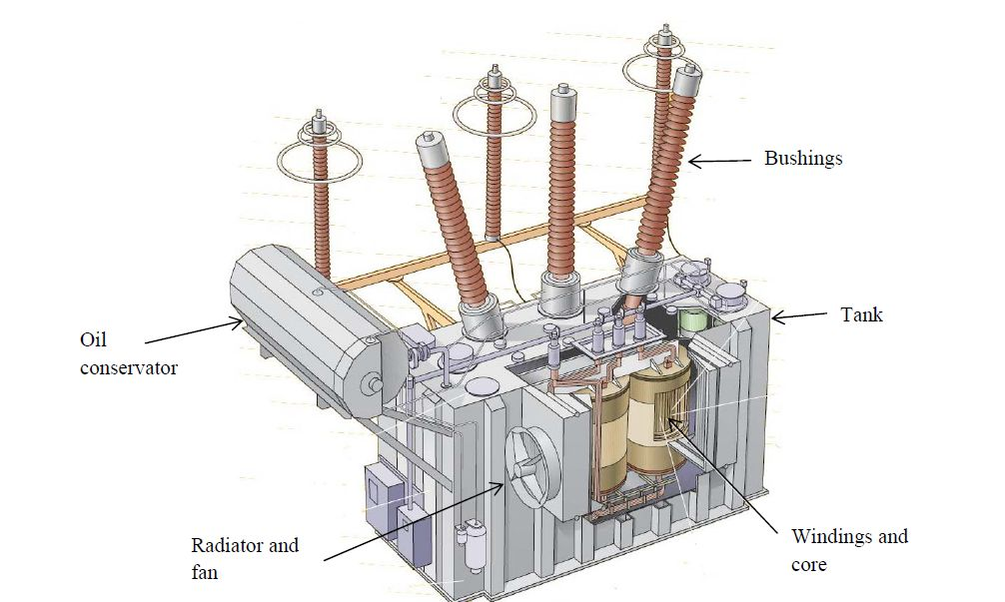
Physical image of Transformer

Slide 7
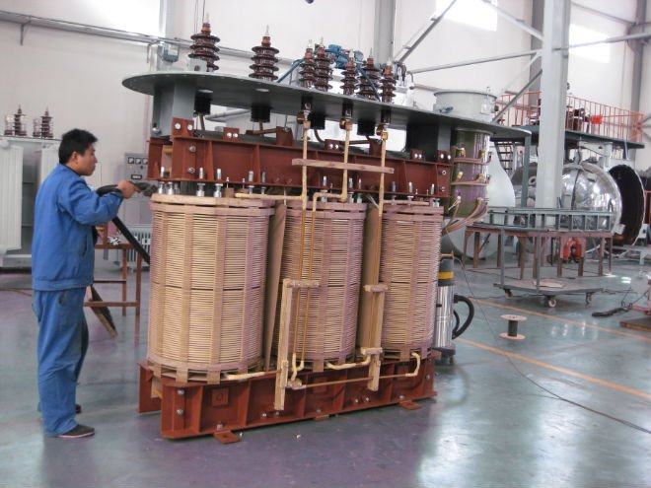
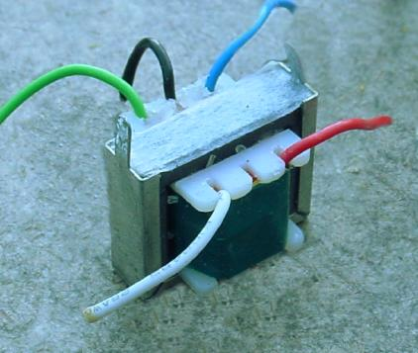
Physical image of Transformer

Slide 8
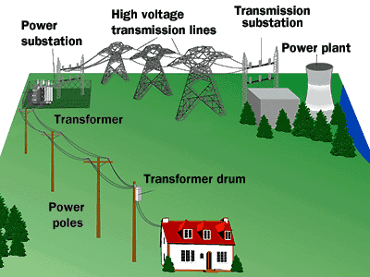
Application of Transformer

Slide 9
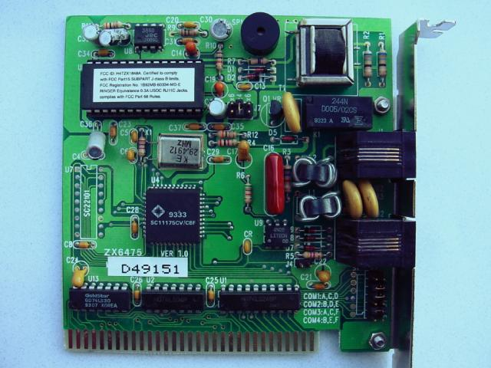
Application of Transformer
Printed circuit board mounted audio impedance matching transformer, top right.

Slide 10
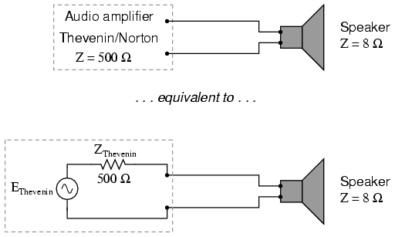
Application of Transformer
If 500 Ω = 500 Ω
maximum power
Such a load drop higher voltage and draw less current than an 8 Ω speaker dissipating the same amount of power
Amplifier with impedance of 500 Ω drives 8 Ω at much less than maximum power.

Slide 11
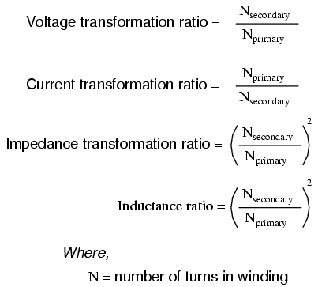
Application of Transformer

Slide 12
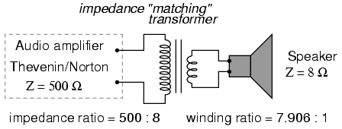
Application of Transformer

Slide 13
Principle of Transformer
The word Transformer refers to transfer
something from one place to other
A Transformer is a static or stationary piece of apparatus by means of which electric power in one circuit is transformed into electric power of the same frequency in another circuit
Although transformers have no moving parts, they are essential to electromechanical energy conversion. They make it possible to increase or decrease the voltage so that power can be transmitted at a voltage level that results in low costs, and can be distributed and used safely

Slide 14
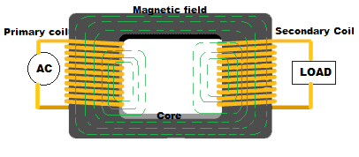
Constructional Parts of a Transformer
Main parts of a transformer :
A typical transformer is constructed with three basic parts
(i) primary winding (ii) secondary winding and a (iii) magnetic core

Slide 15
Constructional Parts of a Transformer
Primary winding: This is a simple coil which is wound by copper wires. This winding generates the required magnetic flux whenever a active AC source is connected across it. It is a closed coil, so whenever an AC voltage is applied across it, current starts flowing. And this flow of current leads to develop an alternating magnetic field surrounding the coil. This winding is used to develop the main magnetic field into the transformer. As the flux generation and creation of magnetic field is initiated from here, so this winding is termed as the primary winding. The primary winding is the input section of a transformer
Core: Core gives the strong mechanical support for the windings as well as serves the necessary path for the magnetic fluxes. Core is generally made up with soft iron or laminated silicon steel. When the magnetic fluxes are generated in the primary winding, it confines them and after that those fluxes are passing through the core. Both primary and secondary windings are connected with a common core. As this magnetic core offers a low reluctance path for the generated magnetic fluxes, so most of the fluxes will go through the core. So they are guided to the secondary winding through the magnetic core.

Slide 16
Constructional Parts of a Transformer
Secondary winding: This is also a copper winding similar to the primary, but the number of turns are different. The generated magnetic fluxes will link this secondary winding by mutual induction method after passing through the magnetic core. Output of a transformer is always taken from the secondary winding terminal that is the load is always connected with this terminal

Slide 17
Working Principle of Transformer
Whenever a closed conductor is placed into a varying magnetic field, a potential difference is developed across the terminals of the conductor
Faradey’s law:
This law states that, if a closed conductor is subjected to a varying magnetic field, then the induced emf in the conductor is equal to the rate of change of flux linkages of that magnetic field.
The induced voltage e = – Ndφ / dt volt

Slide 18
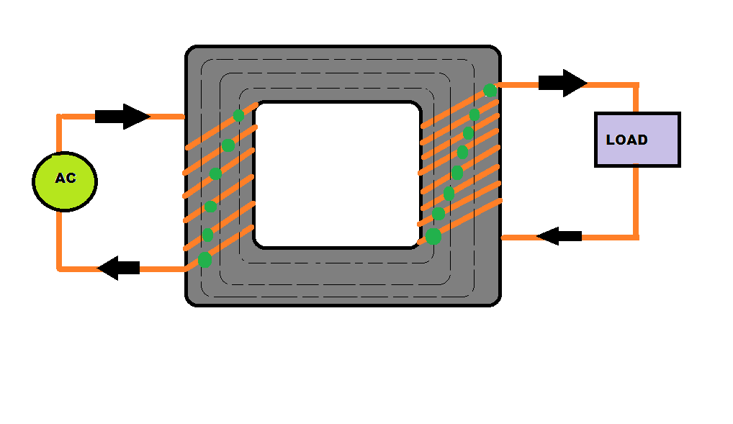
Working Principle of Transformer

Slide 19
Types of Transformer
According to the core construction:
(a) Core type
(b) Shell type
(c) Berry type
According to the voltage ratio :
(a) Step Up transformer
(b) Step down transformer
According to the phase:
(a) Single Phase Transformer
(b) Three Phase Transformer

Slide 20
Types of Transformer
According to the method of cooling:
(a) Self Cooled
(b) Air forced cooled
(c) Oil cooled
(d) forced oil cooled
According to the frequency groups:
(a) Power frequency transformers.
(b) Audio frequency transformers.
(c) Radio frequency transformers.

Slide 21
Types of Transformer
There are many other types of transformers are present according to the specific applications.
Distribution Transformer: Distribution transformers are used in distribution network to step down the voltage level for feeding the local consumers.
Power Transformer: Power transformers are used at each end of transmission line in generating stations and substations for stepping up or down the voltage level.
Current transformer: This transformer is used for the measurement of electric current.
Potential transformer: These type of transformers are used to step down the voltage to low value which can be fed to relay for protection purpose.
Instrument transformers: Current transformers and potential transformer both are called the instrument transformer because their main fuction is to transform high currents and voltages to a standardized low and easily measurable values.
Auto transformer : It is a single winding transformer and a common winding is used as both primary and secondary winding.

Slide 22
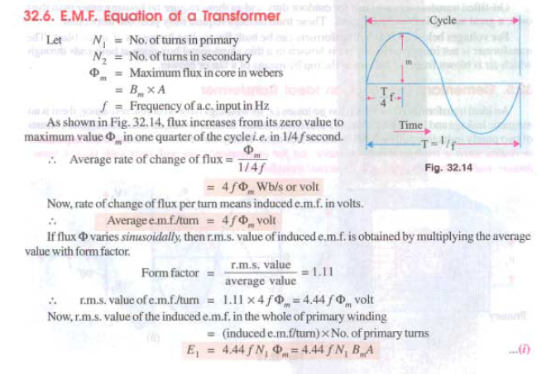

Slide 23
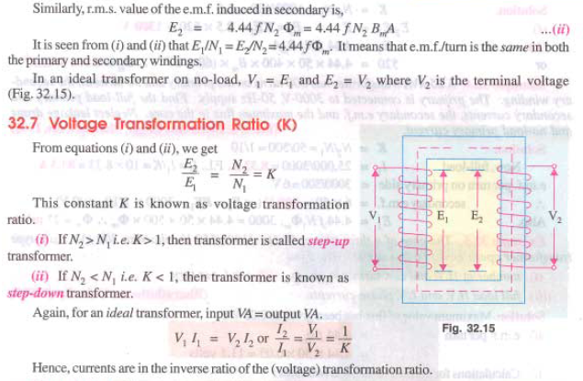

Slide 24
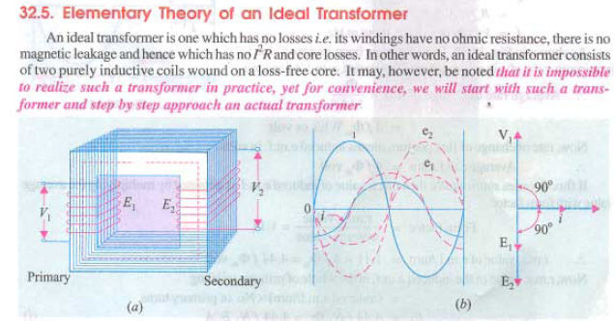

Slide 25
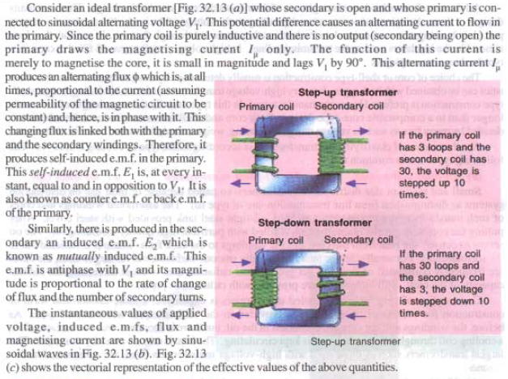

Slide 26
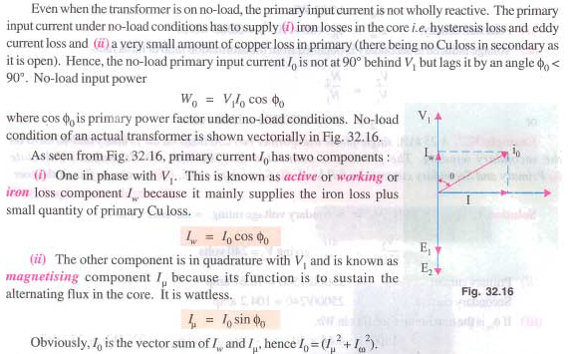

Slide 27
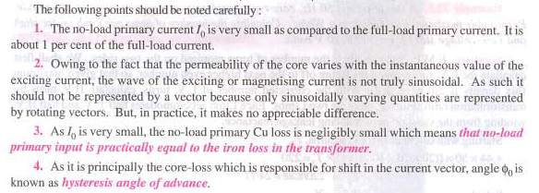

Slide 28
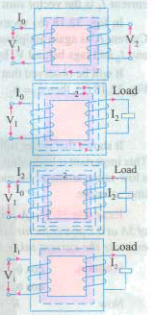

Slide 29
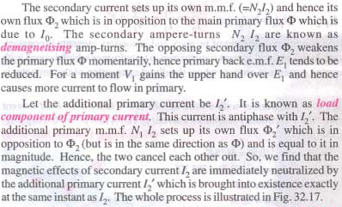

Slide 30
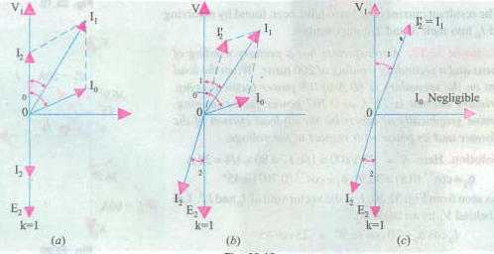

Slide 32
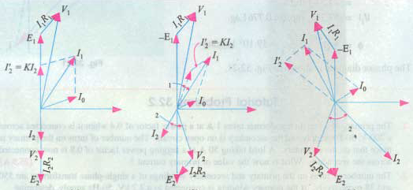

Slide 33
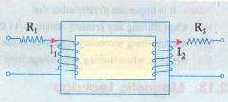

Slide 34
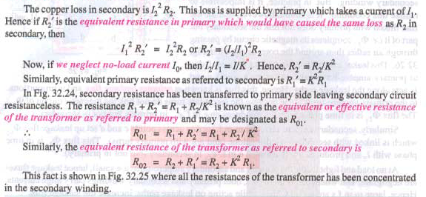

Slide 35
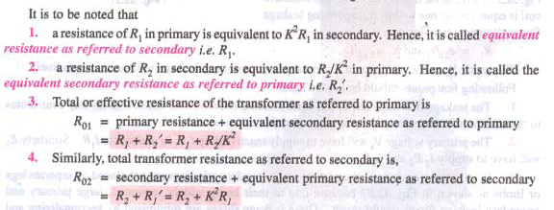

Slide 36
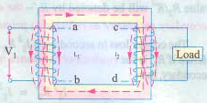
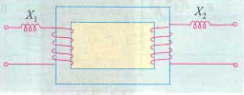

Slide 37
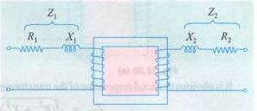

Slide 38
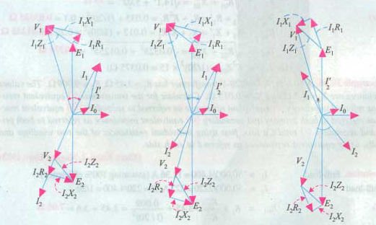

Slide 39
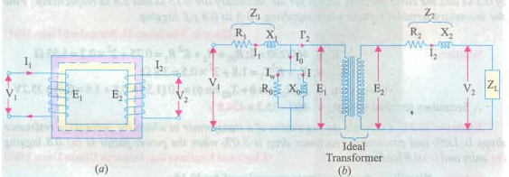

Slide 40
Transfer Voltage, Current, and Impedance either to the primary or secondary

Slide 43
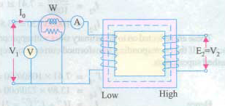

Slide 44
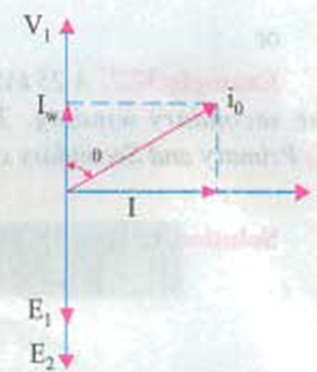

Slide 46
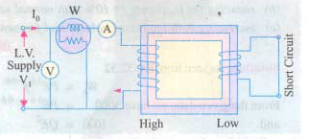
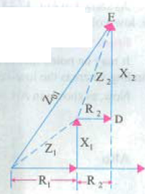
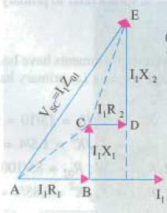

Slide 47
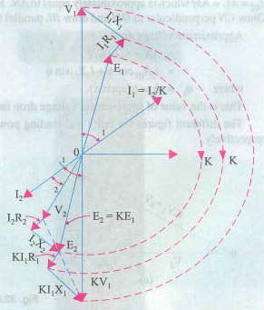

Slide 49
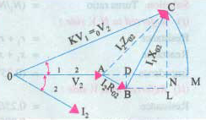
Total approximate voltage drop in Transformer

Slide 50
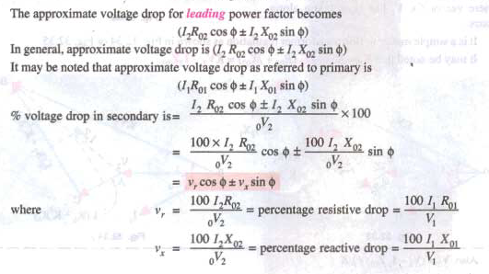

Slide 51
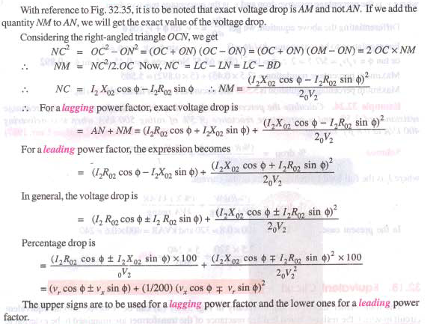
Exact voltage drop in Transformer

Slide 52
Regulation of Transformer
The voltage regulation of the transformer is the percentage change in the output voltage from no-load to full-load.
The voltage regulation can be defined in two ways - Regulation Down and Regulation up.
Regulation down: This is defined as ” the change in terminal voltage when a load current at any power factor is applied, expressed as a fraction of the no-load terminal voltage
Regulation up: Here again the regulation is expressed as the ratio of the change in the terminal voltage when a load at a given power factor is thrown off, and the on load voltage

Slide 53
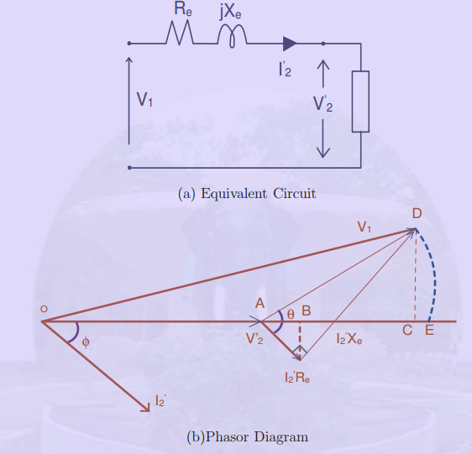

Slide 54
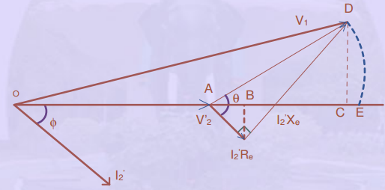
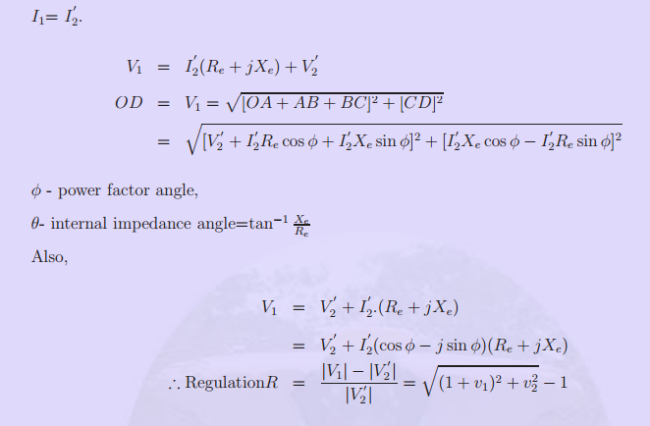

Slide 55
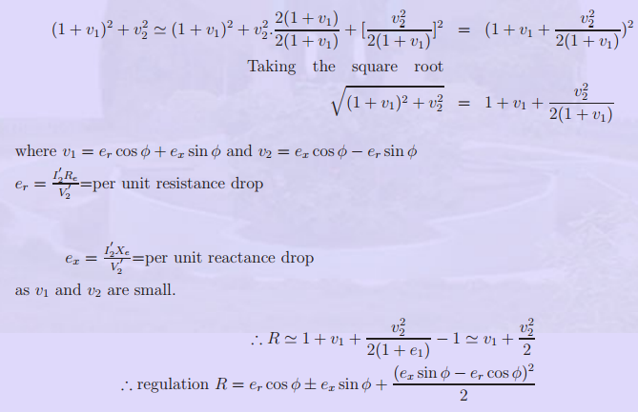

Slide 56
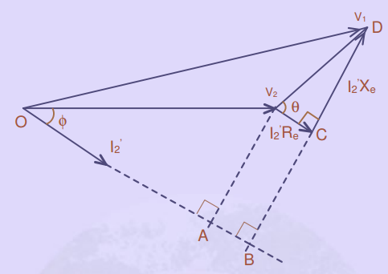

Slide 58
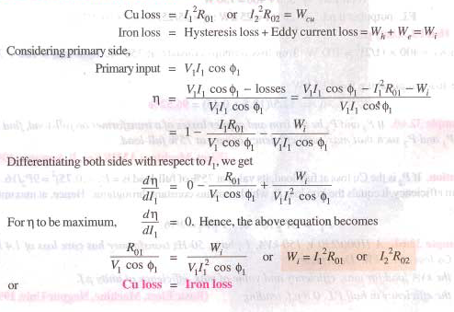

Slide 59
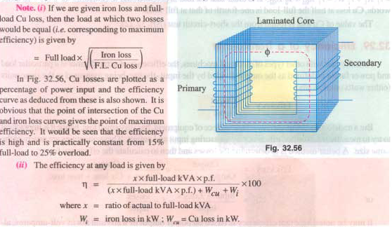

Slide 60
THREE PHASE TRANSFORMERS
Almost all major generation & Distribution Systems in the world are three phase ac systems
Three phase transformers play an important role in these systems
3 phase transformers can be constructed from
3 single phase transformers
(b) 2 single phase transformers
(c ) using a common core for three phase windings

Slide 62
3 phase Transformer connections
By connecting three single phase transformers
Star- Star connection
Delta- Delta connection
Star – Delta connection
Delta – Star connection

Slide 63
This connection satisfactory only in balanced load otherwise neutral point will be shifted.

Slide 64
Advantages
1.Requires less turns per winding ie cheaper
Phase voltage is 1/√3 times of line voltage
2.Cross section of winding is large ie stronger to bear
stress during short circuit
Line current is equal to phase current
3. Less dielectric strength in insulating materials
phase voltage is less

Slide 65
Disadvantages
1.If the load on the secondary side unbalanced then
the shifting of neutral point is possible
2.The third harmonic present in the alternator
voltage may appear on the secondary side. This
causes distortion in the secondary phase voltages
3. Magnetizing current of transformer has 3rd
harmonic component

Slide 66
This connection is used for moderate voltages

Slide 67
Advantages
System voltages are more stable in relation to
unbalanced load
2. If one t/f is failed it may be used for low power
level ie V-V connection
3. No distortion of flux ie 3rd harmonic current not
flowing to the line wire
Disadvantages
Compare to Y-Y require more insulation
2. Absence of star point ie fault may severe

Slide 68
Used to step down voltage ie end of transmission line

Slide 69
Advantages
The primary side is star connected. Hence fewer number of turns are required. This makes the connection economical
The neutral available on the primary can be earthed to avoid distortion.
Large unbalanced loads can be handled satisfactory.
Disadvantages
The secondary voltage is not in phase with the primary. (30 ⁰ phase difference )
Hence it is not possible to operate this connection in parallel with star-star or delta-delta connected transformer.

Slide 70
This connection is used to step up voltage ie. Beginning of high tension line

Slide 71
Features
secondary Phase voltage is 1/√3 times of line voltage
neutral in secondary can be grounded for 3 phase 4 wire system
Neutral shifting and 3rd harmonics are there
Phase shift of 30⁰ between secondary and primary currents and voltages

Slide 72
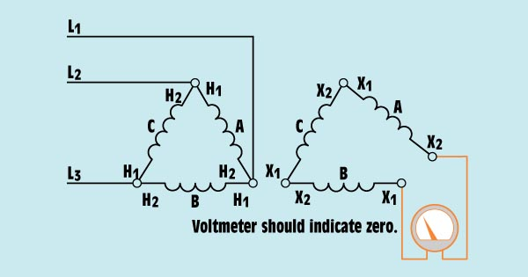
Safety test prior to closing the delta connection.

Slide 73
Harmonics
Harmonics are voltages or currents that operate at frequencies that are multiples of the fundamental power frequency. The fundamental frequency is usually 50 or 60 Hz.
Sine wave distortion caused by harmonics.

Slide 78
Parallel operation of transformers

Slide 80
Conditions for Parallel operation

